Slide 1
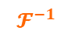
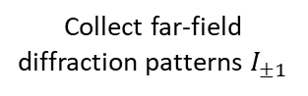
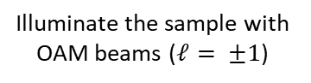

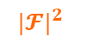

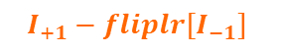
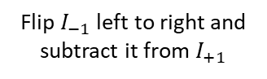
Figure 1. Workflow
Defect on sample
OAM +1
OAM -1
Illuminate the sample with OAM beams ($ℓ= ±1$)
$${|𝓕|}^{2}$$
$$I_{+1}$$
$$I_{−1}$$
Collect far-field diffraction patterns $I_{±1}$
$$I_{+1}−fliplr[I_{−1}]$$
Flip $I_{−1}$ left to right and subtract it from $I_{+1}$
$$𝓕^{−1}$$
Inverse Fourier transform gives the amplitude and phase maps

Slide 2
Figure 2. Common Defects
Notes:
Missing contact / a spot in subplot(232)

Slide 3
Figure 3-1. Noise Analysis

Slide 4
Figure 3-2. Noise Analysis

Slide 5
Figure 3-3. SNR Vs. Defect Power / Detector Area
c*P

Slide 6
Figure 4. Varying OAM

Slide 8
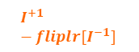
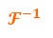
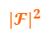
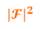
OAM +1
OAM -1
$${|𝓕|}^{2}$$
$${|𝓕|}^{2}$$
$$I^{+1}−fliplr[I^{−1}]$$
$$𝓕^{−1}$$

Slide 9
OAM +1
OAM -1

Slide 10
OAM +1
OAM -1

